Slide 1
Today’s handouts can be downloaded at:
http://psikinderparents.weebly.com/professional-workshops.html
There are also paper copies available.

Slide 2
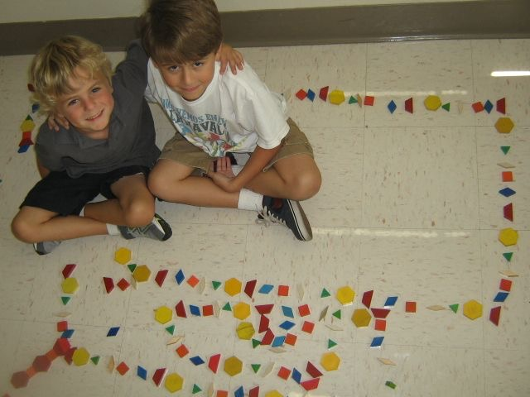
Language Acquisition & Learning Centers
in the Primary Grades
Kim Wieber du Saire
Park Spanish Immersion School
St. Louis Park, Minnesota
July 20, 2018

Slide 3
What to do on Day 1?

Slide 4
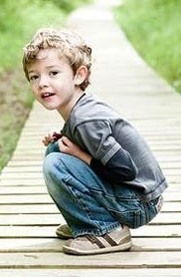
¡Arriba! ¡Abajo!

Slide 5
Early Vocabulary
Up/down
Numbers to 10
Girl/ boy chart
Colors
Letters
Classroom items

Slide 6
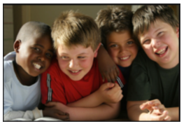
las
niñas
los
niños
Arianna
Kaelin
Jack
Mathew

Slide 7
Sing!
Good morning song – Routine is important!
1,2,3 Amigos
Alphabet song
For first graders: Ask them to teach you songs
from kindergarten
ABC

Slide 8
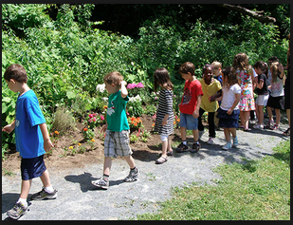
Week 1 Activities
Counting games
Circle games
Number and Color flashcards
Playdough or clay
Free choice play
Journaling
Color bingo
Watercolor painting
Nature walk
Read alouds
Reader’s Theater

Slide 9
Read Aloud Tips
Choose engaging books
-Repetition is important!
-great illustrations
-simple stories
-well-known stories
-interactive phrases
Act out the stories

Slide 10
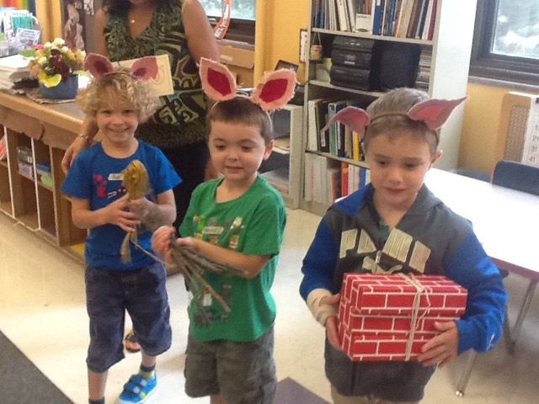
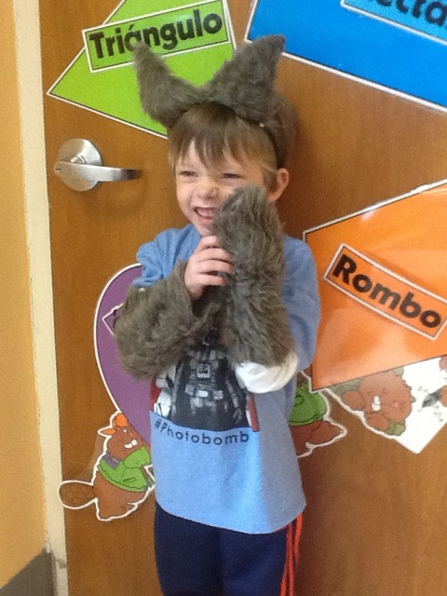
Kindergarten
Week 1
The 3 Little Pigs

Slide 11
Keep in mind…
Repetition…repetition…repetition!
Simple language…they won’t understand you!
Rely on gestures, actions, examples, and photos.
Think ahead to what language you will use
Think ahead to what language you want them to use
Alternate activities to keep the students engaged

Slide 12
What’s important to the kids
Does my teacher like me?
Is this fun?
When do I get to eat?
When and how will I get home and see my mom?

Slide 13
play!
read!
count!
sing!
create!
move!
dance!
Smile…a lot!
Breathe…

Slide 14
Learning Centers
for the Primary Grades

Slide 15
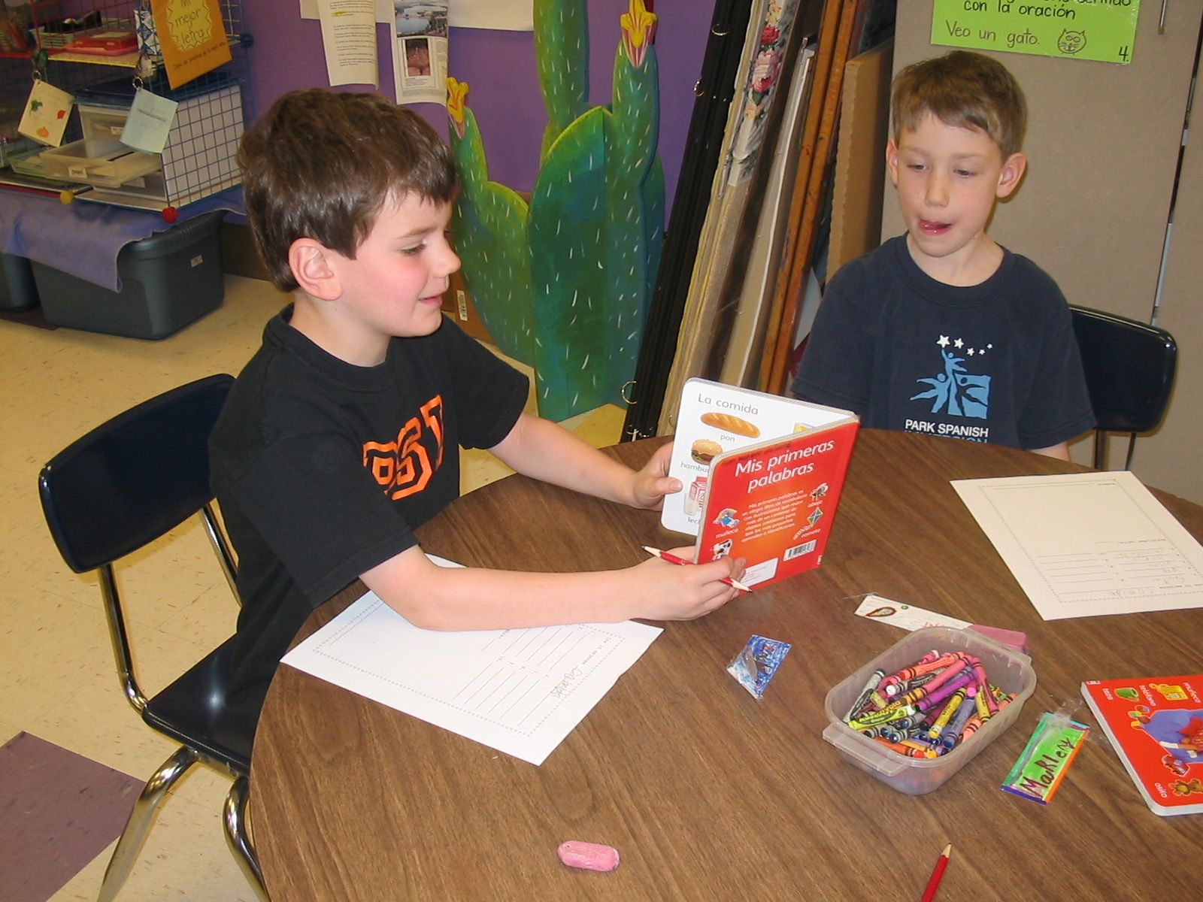
Why use learning centers?
A teacher can work with individual students or a small group,
while at the same time providing other students with
the opportunity to review past topics.
Students work independently, with a partner,
or collaboratively with a small group.

Slide 16
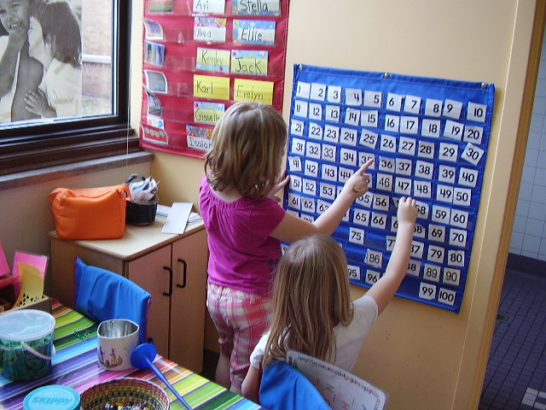
What do learning centers look and sound like?
The teacher may move about the room or work with
a small group. The teacher does not work with the
whole class as a large group during centers time.
Students collaborate or work
individually to complete the
activities in their centers.

Slide 17
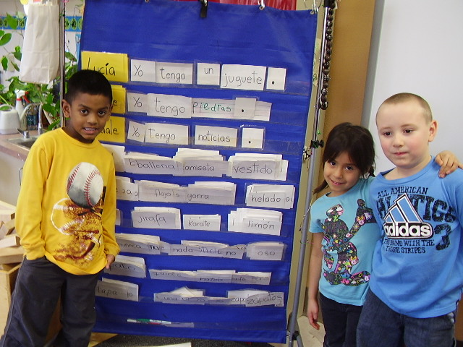

Slide 18
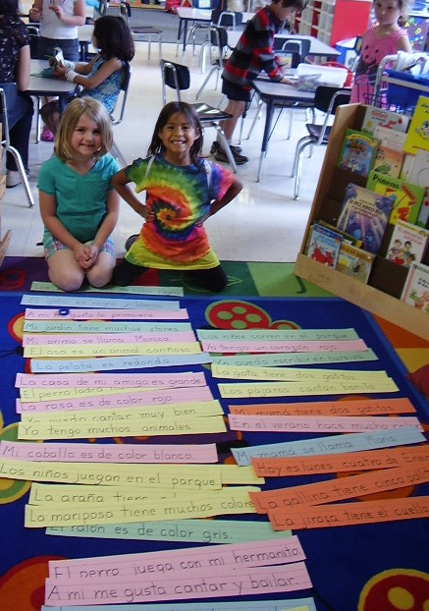
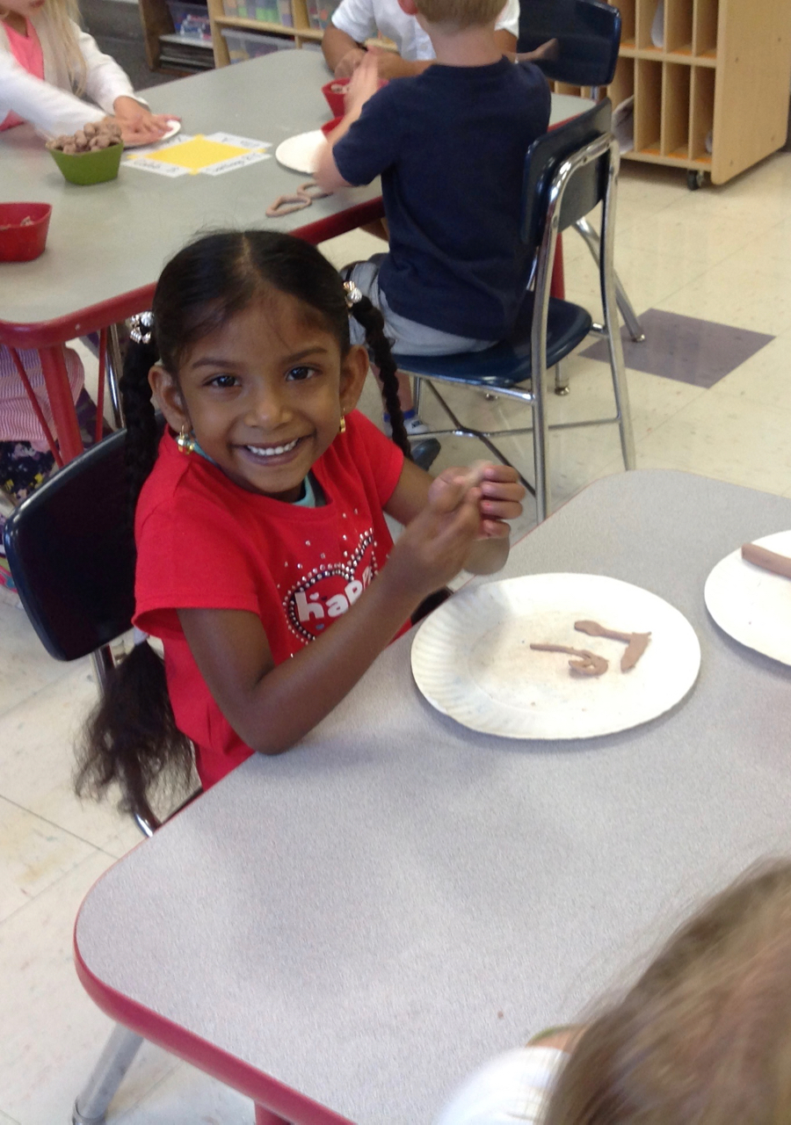

Slide 19
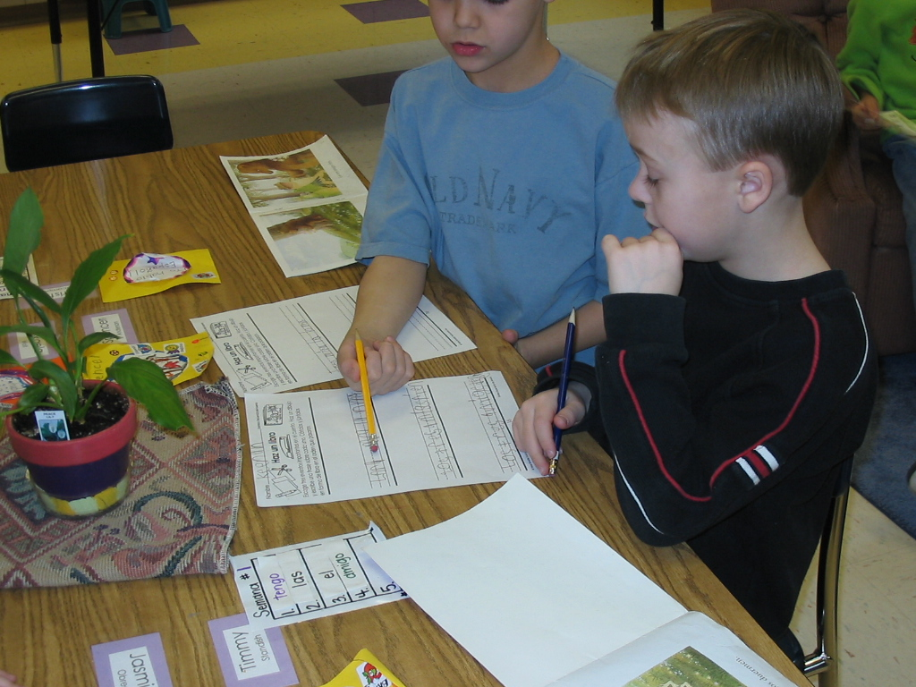
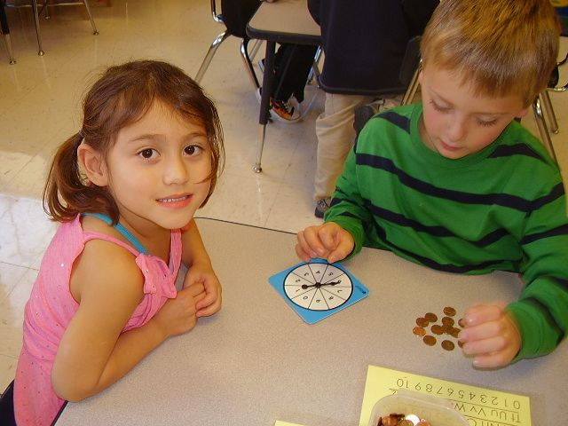

Slide 20
Where do I begin?
First…
Decide how you will use centers in your classroom.

Slide 21
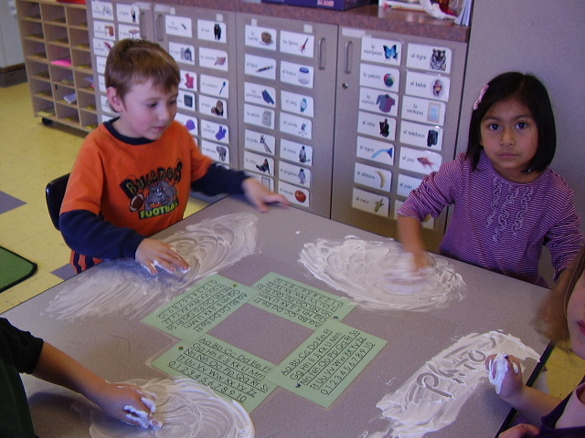
Different Types of Learning Centers
1. The teacher assigns students to each center,
and each center has a specific activity. All students
work in centers at the same time, and rotate through
each center in one week.

Slide 22
How to design this type of learning centers?
Choose a topic and an objective for each center.
The centers could be related to a specific theme.
Example: Birds
Math – Count & graph toy birds
Reading – Read books about birds
Art – Draw and paint a favorite bird
Writing/Science – Label the parts of a bird
Reading/Theater – Read & act out a short play
Students work in pairs or small groups.

Slide 23
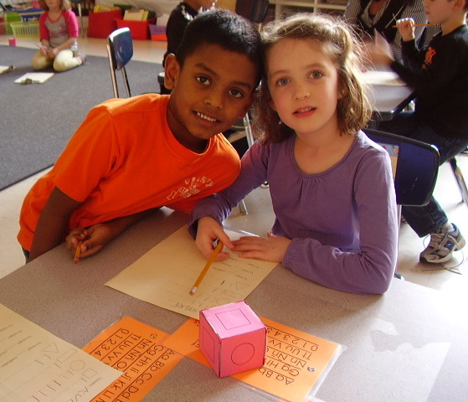
2. Some students work in centers while others
work with the teacher.
Whole group Language Arts lesson
Group 1 – Centers and then LA work
Group 2 – LA work and then Centers
3. Students work in Centers
as part of a math rotation.
Lesson with the teacher
Math centers
Practice activity
Math games

Slide 24
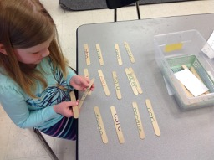
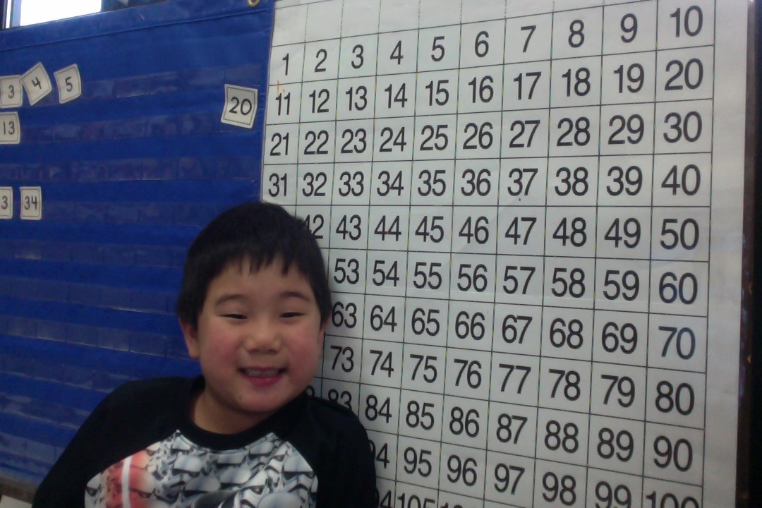
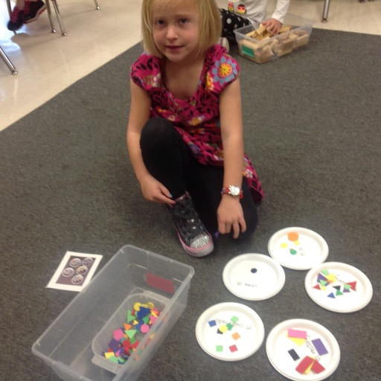

Slide 25
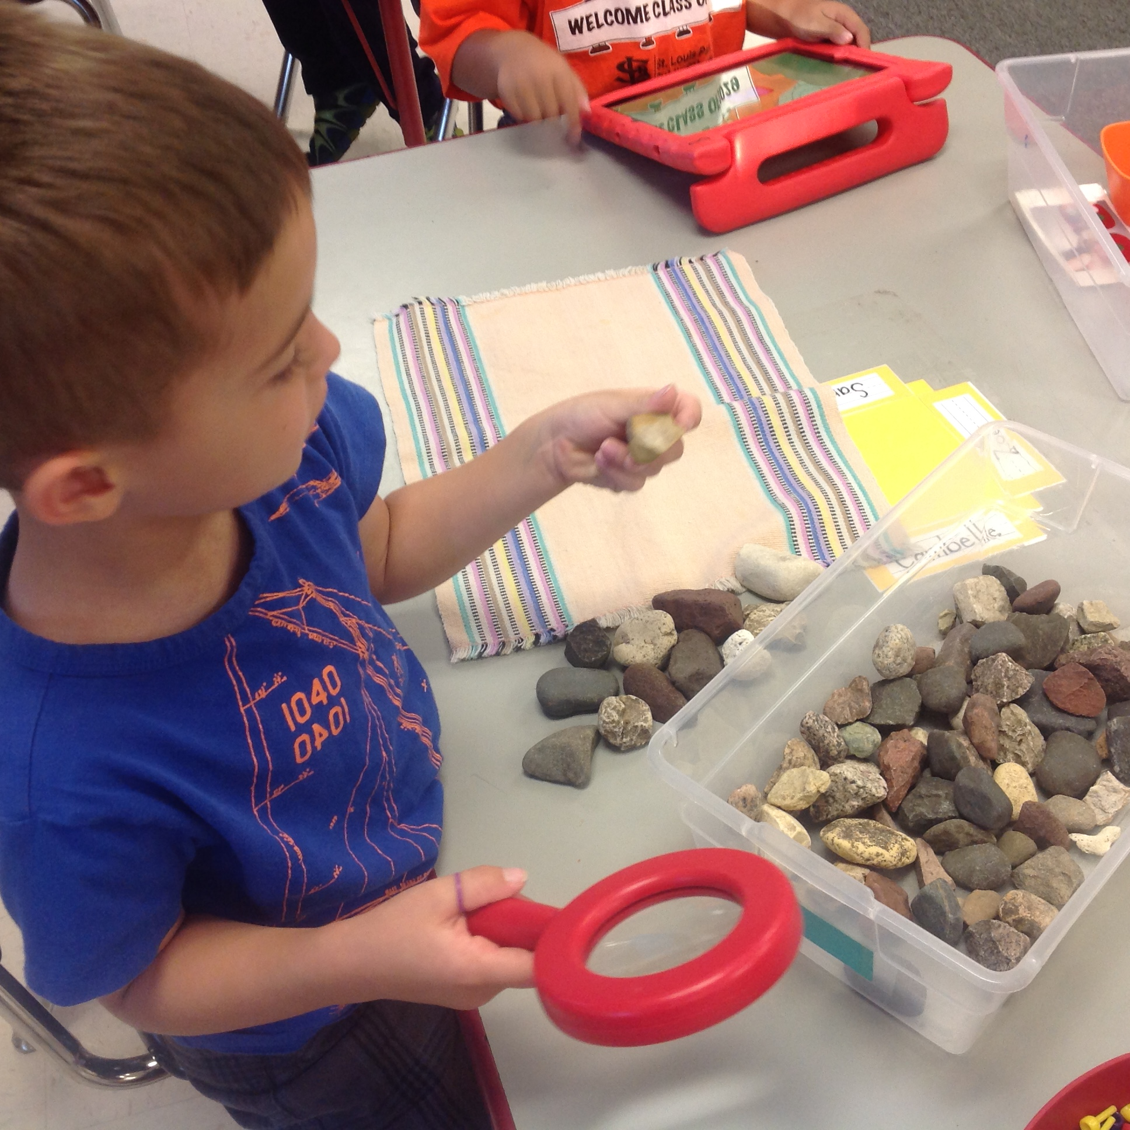
4. Students choose a center for their morning work.
5. Students choose a center when they finish an
assignment. Each center has numerous activities
that students may choose from.

Slide 26
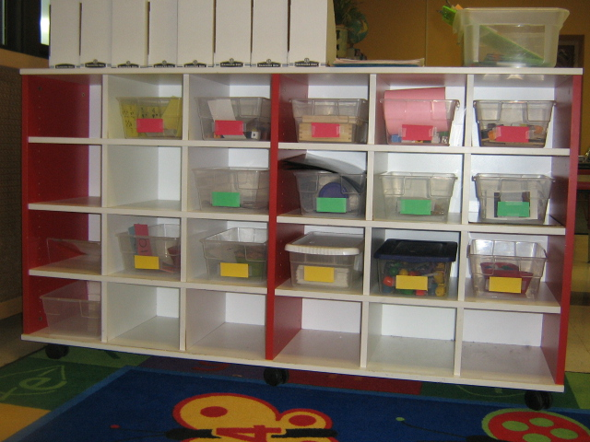
Each center tub has one activity that is the same
for up to a month. Label the centers by color.
Math →
Fine Motor →
Language Arts →
Students work individually.

Slide 27
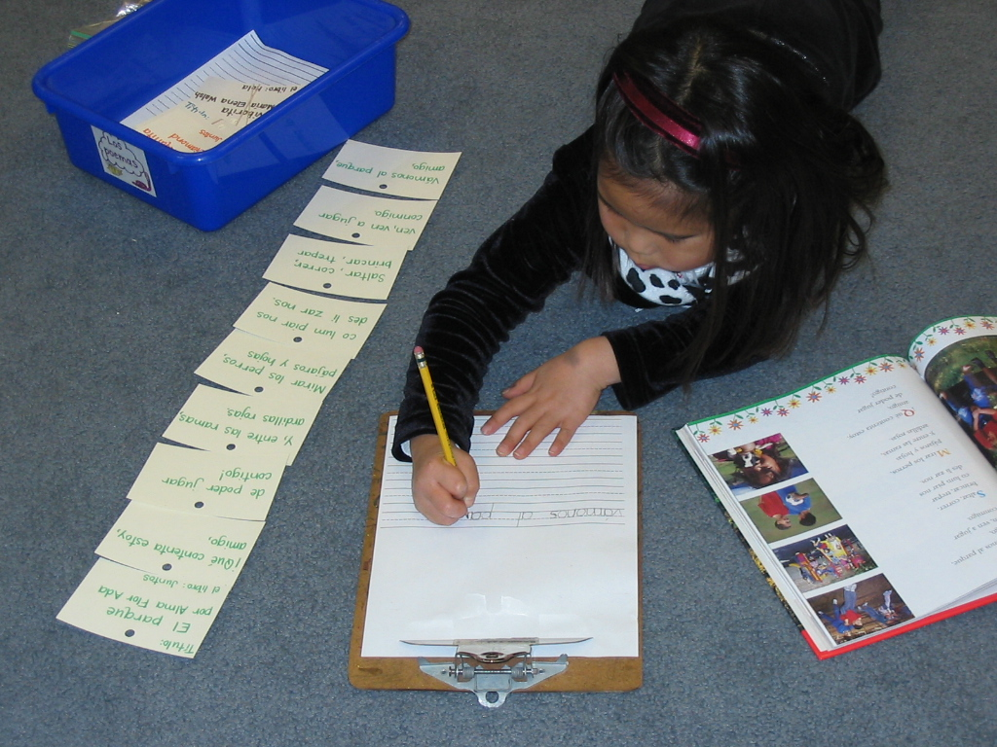
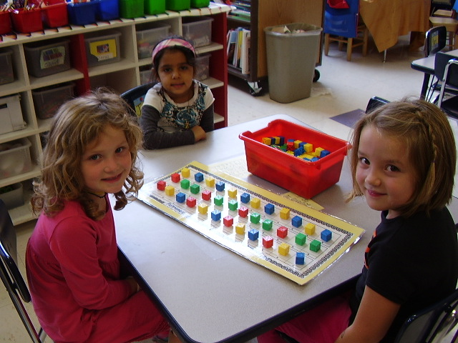

Slide 28
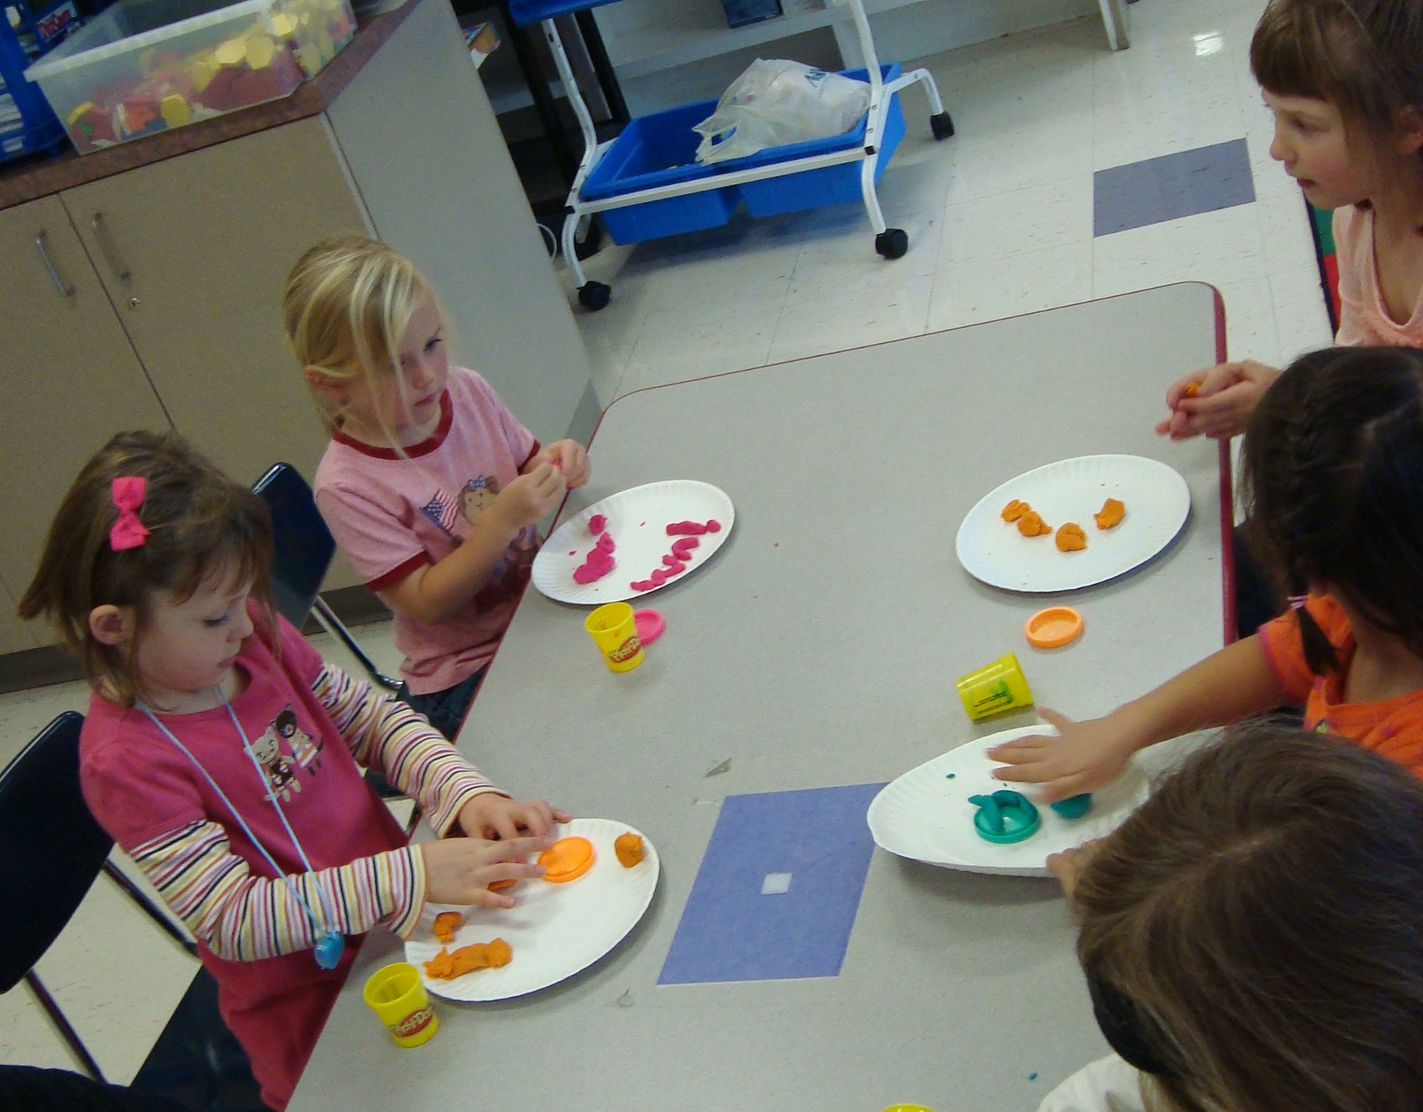
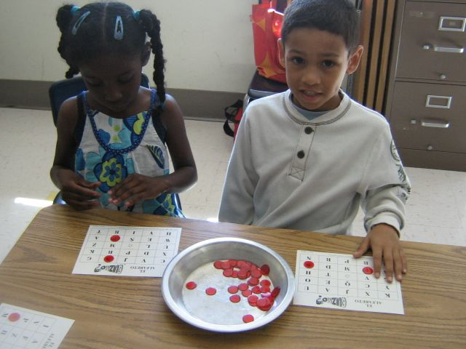

Slide 29
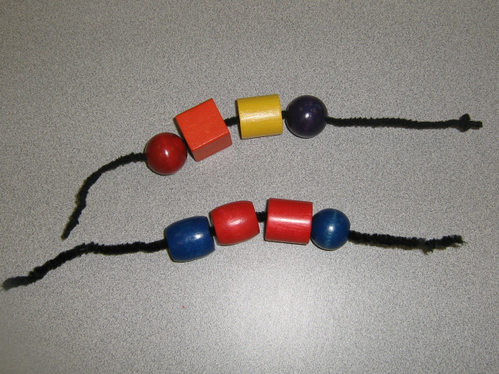
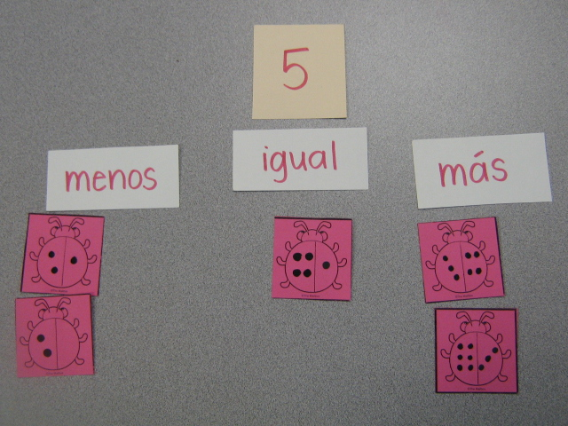
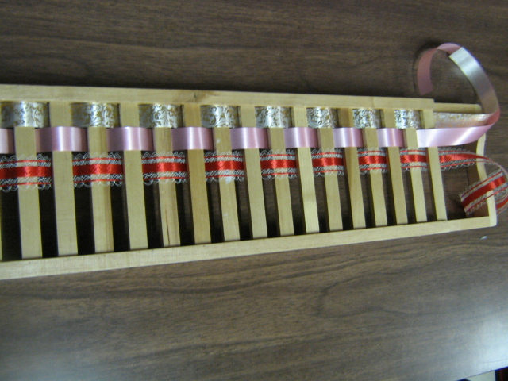
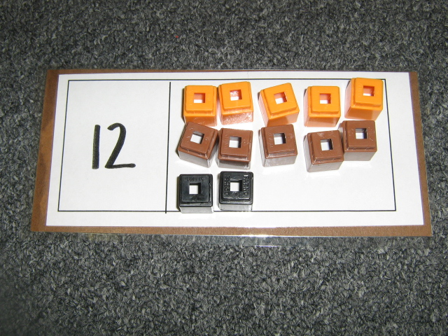
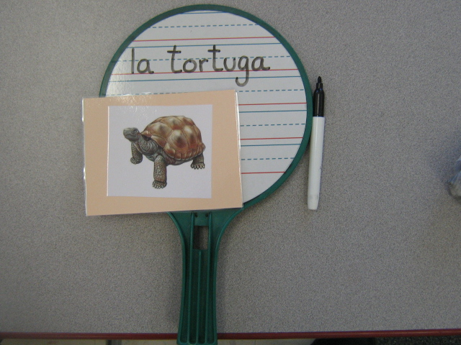
What types of activities should I put
in the centers?

Slide 30
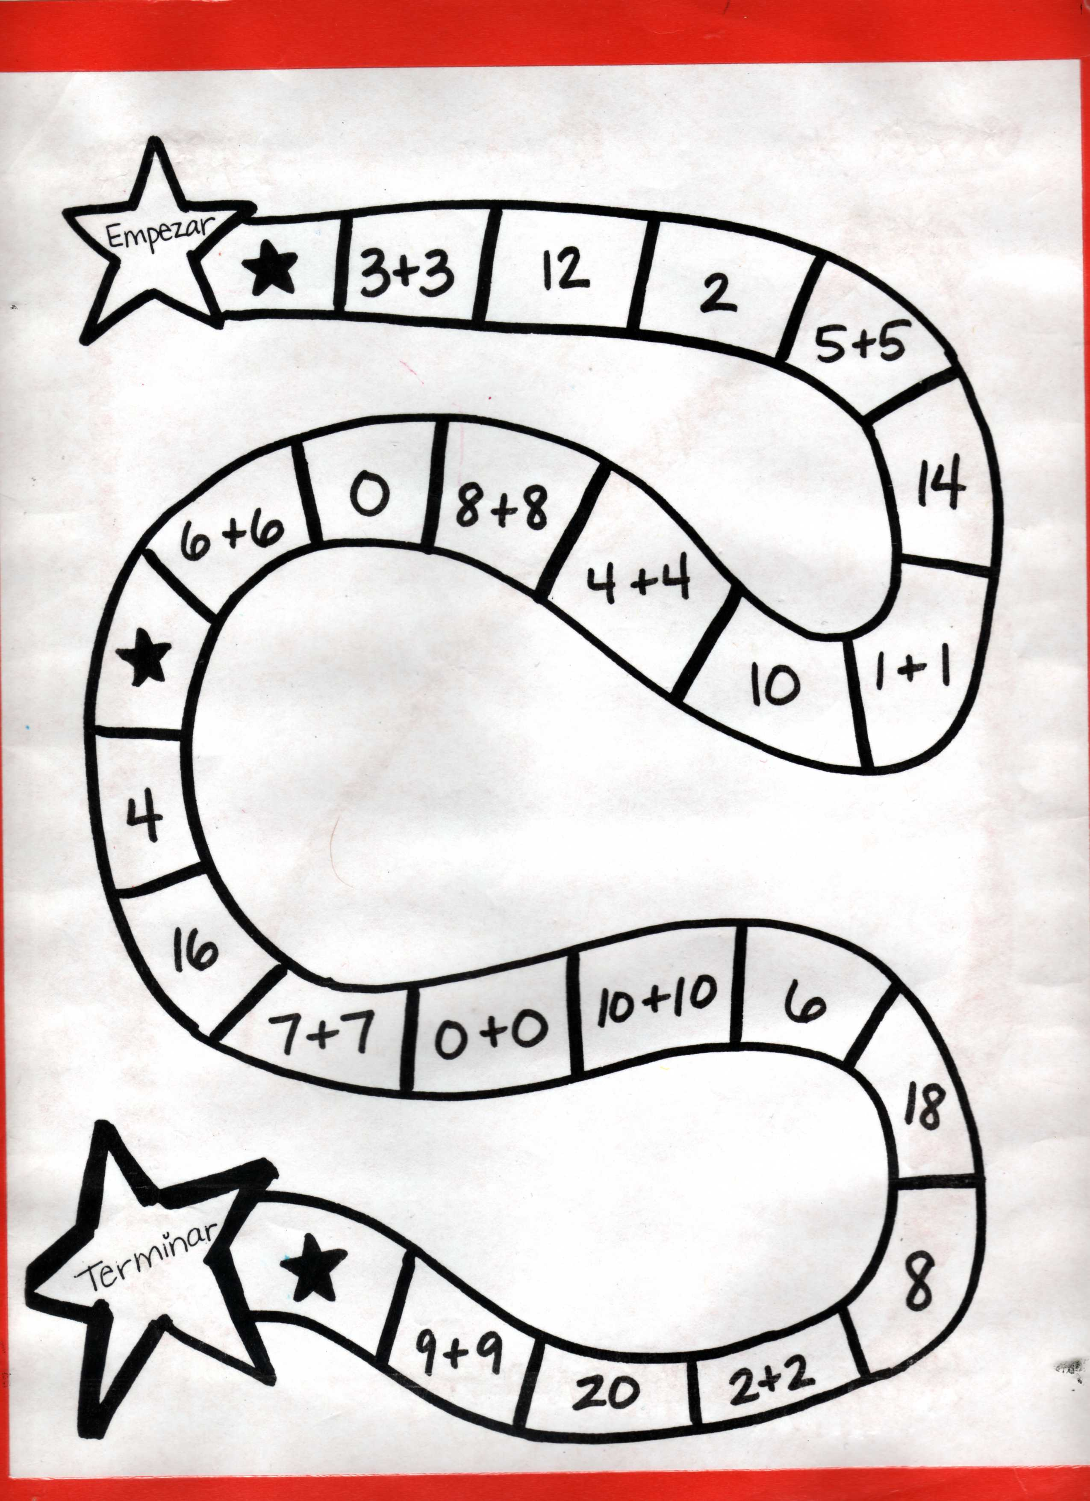

Slide 31
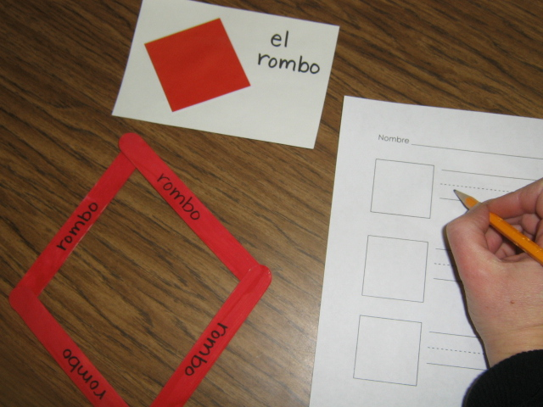
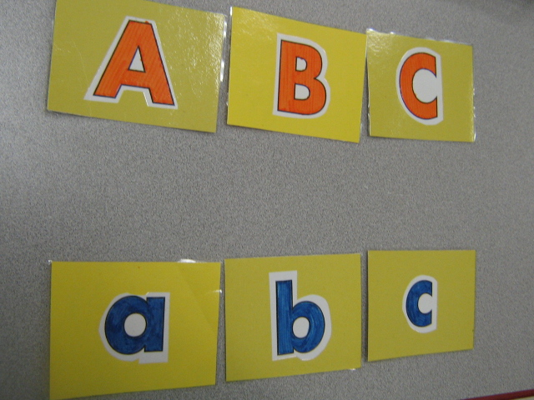
How will students know what to do?
For how many minutes should students
work in centers?
How often should students work in centers?

Slide 32
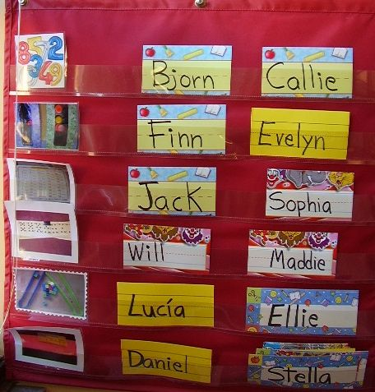
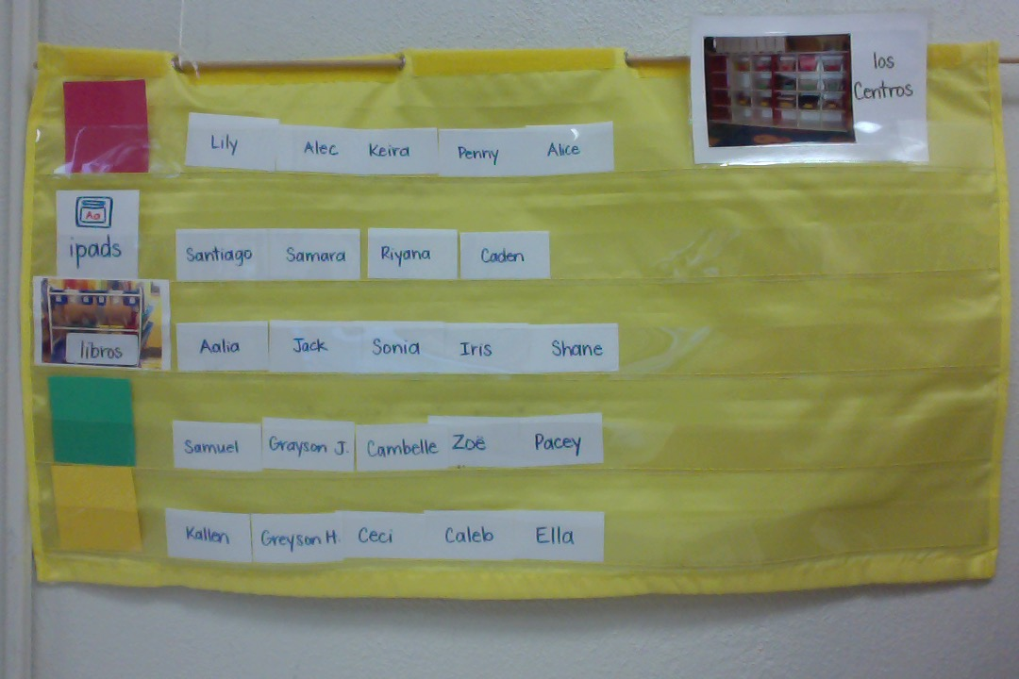
How can I manage all of the centers?
Use a centers chart.
Group students by ability or randomly.
The teacher decides when and to which centers
the students move.

Slide 33
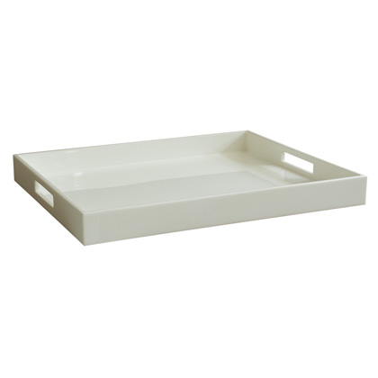
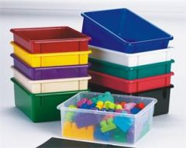
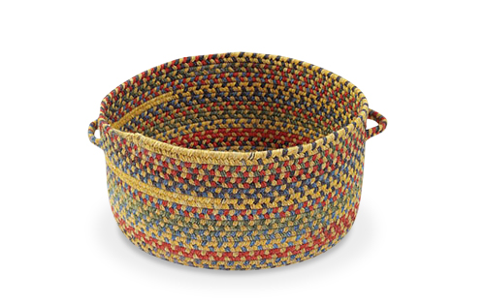
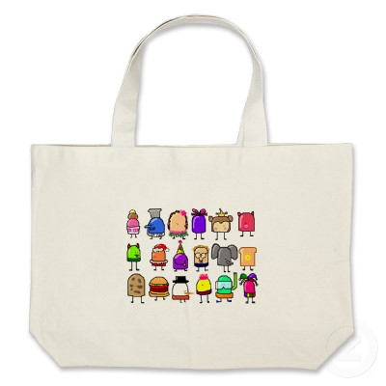
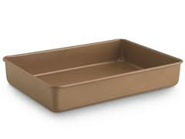
Storing the Centers

Slide 34
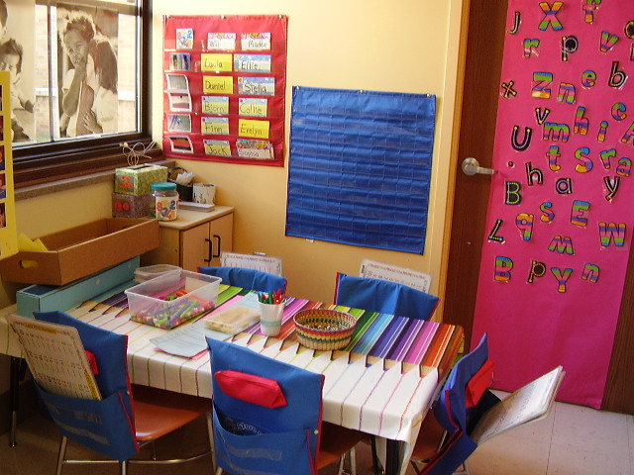

Slide 35
Thank you for sharing your ideas
and learning with me today.
Good luck!
wieber.kimberly@slpschools.org
Park Spanish Immersion School
http://psikinderparents.weebly.com

